Slide 1
Shanxi Jinbo Bio-Pharmaceutical Co.,Ltd.
Group Project
Jan 10, 2024
Group Members(拼音首字母顺序）:
陈睿怡 2301212313
陈 湛 2201212284
偶妙琦 2201212397
肖哲坤 2201212426
张秋雁 2301212290
张煦明 2201212275

Slide 2
Introduction to Shanxi Jinbo Bio-Pharmaceutical Co., Ltd.
&Collagen & Recombinant Collagen Market Analysis
1

Slide 3
1.1 Introduction
Shanxi Jinbo Bio-Pharmaceutical Co., Ltd. (山西锦波生物医药股份有限公司)
The company specializes in cutting-edge technologies such as structural biology applications and rational protein design, focusing on the fields of life health, new materials, and antiviral research.
Company Development
2008
Shanxi Jinbo Bio-Pharmaceutical Co., Ltd. was established
2014
Shareholding reform
Obtained 5 registration certificates for medical skin collagen repair functional excipients and equipment
2018
Upgraded recombinant human type III collagen (second generation) is used in medical device products
The atomic structure of 0.15nm human III collagen was analyzed for the first time
2021
Completed atomic structure analysis of human type I collagen
Recombinant type III humanized collagen freeze-dried fiber has been approved for marketing (trade name: Weiyimei)
2023
Listed on Beijing Stock Exchange

Slide 4
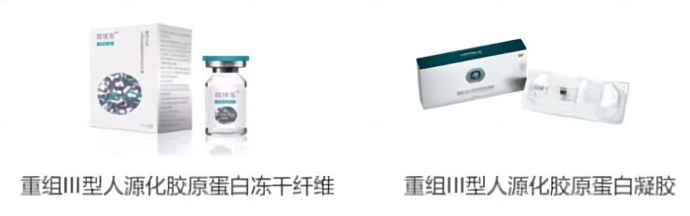
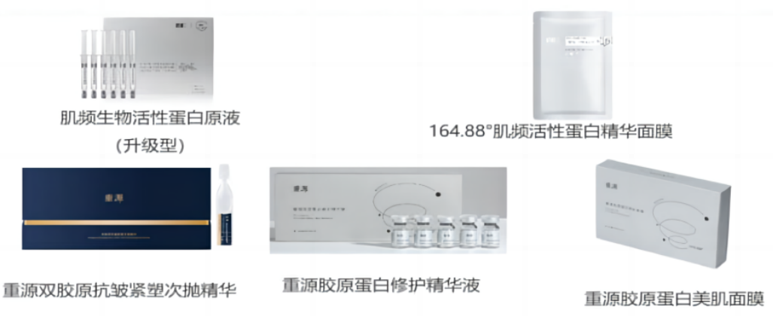
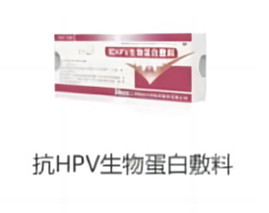
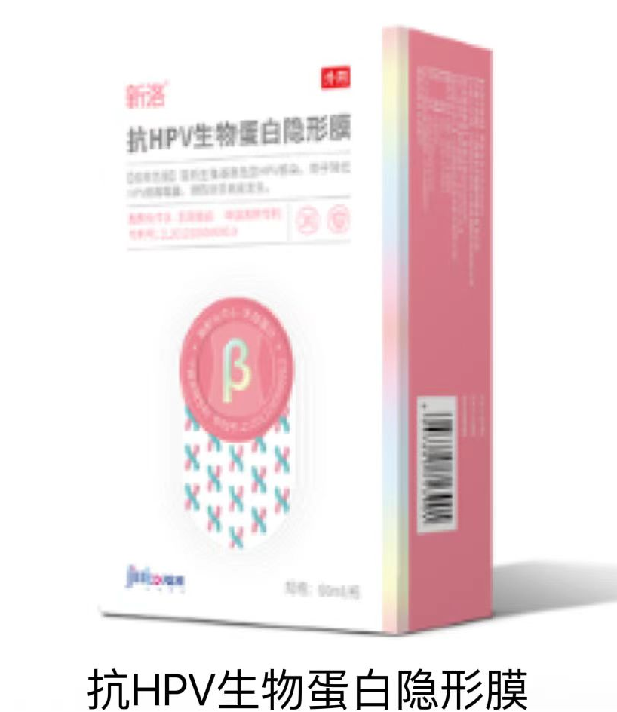
1.2 Product
The company has a rich product pipeline and has an exclusive recombinant collagen Class III medical device license.
core ingredients | registration type | introduction | product picture
recombinant collagen | medical instruments | Key products: implant products (Class III medical devices) and medical dressing products (Class II medical devices) . Promote the independent brand "Wei Yimei“.
 | functional cosmetics | Launch single-ingredient and composite-ingredient functional cosmetics to replenish collagen through topical application.
anti-HPV biological protein | medical instruments | Includes anti-HPV biological protein dressings and anti-HPV biological protein invisible films.

Slide 5
1.3 Key Product: Wei Yimei(薇旖美)
Weimi's specifications are diversified in applications. There are 5 specifications in the Weimi series, including two products in three categories of medical devices.
Weimei implant product is currently the only injectable recombinant collagen Class III medical device product on the market. Compared with other animal-derived products, Weimei can avoid the risk of viral contamination and immunogenicity.
Wei Aimei products are scarce. Currently, there are only 5 approved collagen III mechanical injections on the market from 4 manufacturers.
Weiyimei products have a first-mover advantage in terms of compliance with the water-light injection method. It has the potential to occupy more market share in the future.
Comparison of main products of collagen type III medical device injections:
company | product name | register product name | main ingredients | adaptation | effect duration | price
Jinbo Bio | 薇旖美极纯 | 重组III型人源化胶原蛋白动感纤维 | recombinant type III humanized collagen dynamic fiber | used for facial dermal tissue filling to correct forehead dynamic wrinkles (including glabella lines, forehead lines and crow's feet) | about 3 months | about 6800 yuan/piece
Hanfu Bio (Netherlands) | 爱贝芙 | 整形用胶原和PMMA皮下植入物系统ArteColl | collagen suspension of polymethylmethacrylate microspheres with trace amounts of lidocaine | used to inject into the deep dermis to correct nasolabial folds, or fill into the outer layer of periosteum for rhinoplasty | about 12 months | more than 10,000 yuan/piece
Changchun Feiman | 弗缦 | 医用胶原充填剂 | 3.5% bovine collagen and 0.3% lidocaine hydrochloride in normal saline suspension | used for facial dermal tissue filling to correct moderate to severe nasolabial folds | about 6 months | about 6800 yuan/piece
Shuangmei Biotechnology | 肤柔美 | 胶原蛋白植入剂Sunmax Collagen Implant I | Type I collagen purified from pig skin is dispersed in phosphate saline buffer solution through filtration sterilization and aseptic operation. | used for facial dermal tissue filling to correct forehead dynamic wrinkles (such as glabella lines, forehead lines, crow's feet, etc.) | about 4-6 months | about 4,000 yuan/piece
Shuangmei Bio | 肤丽美 | 胶原蛋白植入剂Sunmax Collagen Implant-Plus | composed of cross-linked type I collagen purified from pig skin and phosphate buffered saline | for injection into the middle to deep layers of facial dermis tissue to correct nasolabial fold gravity wrinkles | about 6-8 months | about 8,000 yuan/piece

Slide 6
1.4 Competitive Advantage
R&D advantages
R&D system is complete and the team is strong.
focus on R&D investment.
technical advantages
have developed the only injection-grade recombinant type III humanized collagen biomedical material.
become the industry standard setter.
product advantages
seize the opportunity during the industry development period.
recombinant type III humanized collagen freeze-dried fiber has become the company's main profit contribution.
Growth Engine
Plan to build 7 new raw material production lines and 5 terminal product production lines
The production lines for the two types of products are put into operation simultaneously, with annual output of 2 million and 50 million pieces respectively.
There is sufficient reserve of products under development,
New gynecological products are worth looking forward to.

Slide 7
1.5 Collagen Industry
Collagen is the most abundant protein in mammalian tissues and a crucial component of the extracellular matrix. It maintains the structure and function of various tissues and organs such as skin, cartilage, tendons, ligaments, and internal organs.
Collagen is distributed throughout different organs in the human body, actively participating in the repair and regeneration of tissue organs.
It is widely used in various fields, including (1) medicine, (2) functional skincare products, (3) food.
Application Field | Function
Pharmaceuticals (including medical devices) | Skin repair, oral cavity restoration, neurosurgery repair
 | Hemostatic materials, particularly effective in trauma-induced bleeding
 | Drug carriers, vaccine adjuvants
 | Injectable filling materials for facial contour correction, wrinkle reduction, scar repair
 | Bone regeneration, cartilage tissue regeneration, oral bone defect repair
 | Cardiovascular applications
Functional Skincare products | Skin whitening, moisturizing, anti-aging
Food | Artificial collagen capsules, chewable tablets, protein powders...

Slide 8
1.6 Market Potential & Policies
2017-2021 Domestic Collagen Terminal Market Size
Mkt Size | 2017 | 2018 | 2019 | 2020 | 2021
Medical Use | 9 | 16 | 32 | 44 | 73
Aesthetic Use | 16 | 21 | 26 | 28 | 37
Sum | 25 | 37 | 58 | 72 | 110
Data Source: Juzi biological prospectus, Minsheng Securities Research Institute
State Food and Drug Administration emphasizes Recombinant collagen a lot.
Recombinant collagen can be divided into three types: (1) recombinant human collagen, (2) humanized collagen, (3)collagen-like protein, according to "Guiding Principles for the Naming of Recombinant Collagen Vital Materials".
Issue Time | Documents | Brief Content
2021.3.15 | Guiding Principles for Nomenclature of Recombinant Collagen Biomaterials | To guide the naming of recombinant collagen biomaterials (Excluding collagen biomaterials derived from animal tissues)
2021.4.15 | Principles for Classification and Definition of Recombinant Collagen Medical Products | Standardize the management attributes and classification of recombinant collagen medical products
2022.3.24 | Classification of Medical Devices | Cold compress paste, cold compress gel products may not continue to produce and import Class I medical devices
2022.4.24 | Project of Recombinant Humanized Collagen | Encourage the research and development and innovation of new biological materials of recombinant humanized collagen, and promote the high-quality development of the medical device industry

Slide 9
1.7 RC Industry Developing Status
The RC industry scale has increased yearly,
and recombinant collagen achieved higher market share by year.
According to Frost & Sullivan, in 2021, the market size of domestic recombinant collagen products reached 10.8 billion RMB, with a CAGR of 63.0% from 2017 to 2021. It is estimated that the market size of recombinant collagen products in China will reach 18.2 billion yuan in 2022, and the penetration rate in the collagen market will increase to 46.6%.
Market Situation of Recombinant Collagen in China, 2017-2022
 | 2017 | 2018 | 2019 | 2020 | 2021 | 2022
Market size | 15 | 25 | 44 | 64 | 108 | 182
Growth | - | 66.7% | 76% | 45.5% | 68.8% | 68.5%
Penetration | 15.9% | 20.2% | 26.3% | 31.4% | 37.7% | 46.6%

Slide 10
1.8 RC in Efficacy Skin Care Market
Consumers' concept of beauty care is deepening, and the demand for fine skin care is increasing. Therefore, functional skin care products have achieved more attention by consumers.
According to Juzi Biology prospectus, by 2021, the market size of China's effective skin care products will reach 30.8 billion RMB, with a CAGR of 26.32% in five years.
As an important raw material, the market size of collagen has risen rapidly, from 1.6 billion RMB in 2017 to 6.2 billion RMB in 2021.
Among them, recombinant collagen increased from 800 million RMB to 4.6 billion RMB.
Domestic Market Size of Efficacy Skin Care Market, 2017-2022
Market size | 2017 | 2018 | 2019 | 2020 | 2021 | 2022
Recombiant C- | 8 | 13 | 20 | 29 | 46 | -
Animal C- | 8 | 10 | 11 | 12 | 16 | -
Sum Collagen | 16 | 23 | 31 | 41 | 62 | -
Hyaluronic acid | 25 | 34 | 43 | 55 | 78 | -
Others | 92 | 107 | 122 | 137 | 168 | -
Sum all | 133 | 164 | 196 | 233 | 308 | 411

Slide 11
1.9 RC in Medical Dressing Market
Medical dressings are defined as adjunctive therapeutic products used for medical surgery and skin repair needs.
Consumer groups:
(1) skin disease patients, (2) skin repair after medical art, (3) functional skin care.
Medical dressings can be divided into: patch type and non-patch type.
Domestic Market Size of Medical Dressing, 2017-2021
Market size | 2017 | 2018 | 2019 | 2020 | 2021
Medical dressing | 67 | 95 | 143 | 182 | 259
YOY | - | 41.8% | 50.5% | 27.3% | 42.3%
Patch share | 84.2% | 87.5% | 86.2% | 79.2% | 76.4%
Non-patch share | 15.8% | 12.5% | 13.8% | 20.8% | 23.6%
Materials Used in Medical Dressing, 2017-2021
Market size | 2017 | 2018 | 2019 | 2020 | 2021
Collagen Sum | 13.4% | 16.8% | 23.1% | 24.7% | 28.2%
RC | 6% | 8.4% | 13.3% | 15.4% | 18.5%
Hyaluronic acid | 28.4% | 32.6% | 42% | 44% | 44.4%

Slide 12
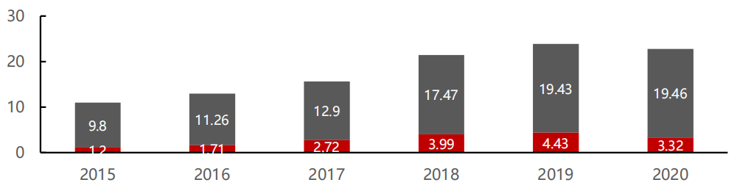
1.10 Other Products Related
Anti-hpv biological protein market:
Market potential is huge, and the domestic sales are 332 million RMB in 2020.
IARC claimed that more than 99% of cervical cancers are associated with HPV infection. In China, cervical cancer has become the sixth desease, the seventh death rate.
The company has successfully developed anti-HPV biological protein products with anhydride bovine beta-lactoglobulin as the core component for the treatment of gynecological diseases.
In 2020, the sales amount of domestic anti-HPV drugs and medical products will reach 2.279 billion RMB, of which functional lactoglobulin will be 332 million RMB.
Anti-hpv Drug Materials Sales, 2015 - 2020
Biological protein products
others

Slide 13
2
Financial Analysis

Slide 14
2.1 General Analyses: Revenue & Profit
Driven by product innovation, the company's performance has grown rapidly
From 2020 to 2022: operating revenue’s CAGR 55.55%, and net profit’s CAGR 84.86%
The company's gross profit margin and net profit margin are showing a growth trend, and are higher than the industry average.
Operating Revenue and Growth Rate
Net Profit and Growth Rate

Slide 15
2.1 General Analyses: Gross Profit Margin
Gross profit margin: over 80%; recombinant collagen and Anti HPV biological protein products are relatively high compared to other products

Slide 16
2.1 General Analyses: Revenue (by product type)
Recombinant Collagen: rapid revenue growth and rising proportion of income
Anti HPV biological protein products: relatively stable
Item | 2022 |  |  | 2021 |  |  | 2020
 | amount | proportion | YoY | amount | proportion | YoY | amount | proportion | YoY
recombinant collagen | 33392.24 | 85.60% | 104.98% | 16290.79 | 69.81% | 60.95% | 10121.7 | 62.96% | 61.79%
among:
medical instruments | 25472.62 | 65.30% | 212.63% | 8147.74 | 34.91% | 88.33% | 4326.38 | 26.91% | 131.7%
functional cosmetics | 6596.96 | 16.91% | -6.08% | 7023.79 | 30.10% | 28.93% | 5447.56 | 33.89% | 32.12%
raw material | 1043.23 | 2.67% | 50.17% | 694.69 | 2.98% | 482% | 119.37 | 0.74% | 1250%
hygiene products | 279.44 | 0.72% | -34.18% | 424.57 | 1.82% | 85.91% | 228.38 | 1.42% | -11.10%
Anti HPV biological protein products | 4670.25 | 11.97% | -16.19% | 5572.69 | 23.88% | 19.27% | 4672.41 | 29.06% | -24.99%
among:
medical instruments | 4610.62 | 11.82% | -15.42% | 5451.29 | 23.36% | 18.31% | 4607.51 | 28.66% | -23.08%
functional cosmetics | 59.63 | 0.15% | -50.88% | 121.4 | 0.52% | 87.09% | 64.89 | 0.40% | -72.86%
Others | 947.84 | 2.43% | -35.68% | 1473.56 | 6.31% | 14.94% | 1282 | 7.97% | -23.07%
Total | 39010.33 | 100% | 67.15% | 23337.04 | 100% | 44.75% | 16076.12 | 100% | 3.42%

Slide 17
2.1 General Analyses: Revenue (by product type)
OBM: definition (company produces and sells self branded products); representative brand (Wei Yimei, 薇旖美); financial characteristics (high proportion of income); direct selling (rising proportion)
ODM: definition (develop products based on brand’s customer commission); representative brand (Wei Yimei, 伯纳赫); financial characteristics (relatively smaller proportion)
Item | 2022 |  | 2021 |  | 2020 |  | 2019
 | money | proportion | money | proportion | money | proportion | money | proportion
OBM | 34375.34 | 88.12% | 18123.24 | 77.66% | 12808.23 | 79.67% | 11824.31 | 83.56%
among:
direct selling | 17363.77 | 44.51% | 7814.98 | 33.49% | 5192.46 | 32.30% | 2503.74 | 17.69%
among:
offline | 14943.56 | 38.31% | 6361.69 | 27.26% | 4200 | 26.13% | 666.11 | 4.71%
online | 2420.22 | 6.20% | 1453.29 | 6.23% | 992.46 | 6.17% | 1837.62 | 12.99%
Total | 39010.33 | 100% | 23337.04 | 100% | 16076.12 | 100% | 14151.52 | 100%

Slide 18
2.1 General Analyses: Expenses
Expenses: increasing expenses; decreasing management expense ratio; stronger operational capabilities

Slide 19
2.1 General Analyses: R&D Expenses
R&D Expenses: increasing R&D expenses; decreasing R&D expense ratio; strong R &D team

Slide 20
2.2 Strength & Weaknesses
Strengths
Star product “Recombinant Type III Humanized Collagen Lyophilized Fiber” seizes scarce market share
High intensity of research
Rich product reserves and continuous expansion of production capacity
Potential Problems
Limited revenue scale (2022)
High asset liability ratio
YoY | Operating Revenue | Net Profit | Net Profit Margin
爱美客 | 19.38 | 12.63 | 65.17%
华熙生物 | 63.59 | 9.71 | 15.27%
锦波生物 | 3.90 | 1.09 | 27.95%
 | 2022 | 2021 | 2020
诺唯赞 | 23.2 | 10.41 | 17.33
华熙生物 | 23.02 | 24.01 | 12.22
创尔生物 | 14.04 | 23.33 | 15.27
百普赛斯 | 6.11 | 3.10 | 10.45
巨子生物 | 9.60 | 87.09 | 82.72
Average | 15.19 | 29.59 | 27.60
锦波生物 | 45.95 | 40.54 | 34.32
Limited impact of popular products: Recombinant humanized collagen implant accounts for less than 30% of the sale

Slide 21
3
Evaluation

Slide 22
3.1 Evaluation: Operating Model
P&L: based on category segmentation and forecast
Assumptions
86%
 | 2020A | 2021A | 2022A | 2023E | 2024E | 2025E | 2026E | 2027E
1. Recombinant collagen | 10,121.69 | 16,290.79 | 33,392.25 | 54,418.16 | 78,391.61 | 105,174.69 | 131,669.23 | 157,685.77
yoy |  | 60.95% | 104.98% | 62.97% | 44.05% | 34.17% | 25.19% | 19.76%
Gross margin | 78.33% | 81.69% | 86.05% | 88% | 88% | 86% | 85% | 85%
Medical devices | 4,326.38 | 8,147.74 | 25,472.62 | 43,612.09 | 64,394.01 | 87,817.98 | 111,129.64 | 133,355.57
yoy |  | 88.33% | 212.63% | 71.21% | 47.65% | 36.38% | 26.55% | 20.00%
The Weiyimei series | - | 2,847.12 | 11,664.09 | 25,661.00 | 41,057.60 | 57,480.64 | 74,724.83 | 89,669.80
yoy |  |  | 77.06% | 120% | 60% | 40% | 30% | 20%
Other medical device | 4,326.38 | 5,300.62 | 13,808.53 | 17,951.09 | 23,336.41 | 30,337.34 | 36,404.80 | 43,685.77
yoy |  | 22.52% | 160.51% | 30% | 30% | 30% | 20% | 20%
Functional skincare products | 5,447.56 | 7,023.79 | 6,596.96 | 8,905.90 | 11,577.66 | 14,472.08 | 17,366.50 | 20,839.80
yoy |  | 28.93% | -6.08% | 35% | 30% | 25% | 20% | 20%
Raw materials | 119.37 | 694.69 | 1,043.23 | 1,564.85 | 2,034.30 | 2,441.16 | 2,685.27 | 2,953.80
yoy |  | 481.96% | 50.17% | 50% | 30% | 20% | 10% | 10%
Hygiene products | 228.38 | 424.57 | 279.44 | 335.33 | 385.63 | 443.47 | 487.82 | 536.60
yoy |  | 85.91% | -34.18% | 20% | 15% | 15% | 10% | 10%
2. Anti-HPV biological protein | 4,672.40 | 5,572.69 | 4,670.25 | 5,134.29 | 5,644.59 | 6,205.76 | 6,822.89 | 7,501.55
yoy |  | 19.27% | -16.19% | 9.94% | 9.94% | 9.94% | 9.94% | 9.95%
Gross margin | 88.44% | 88.51% | 86.39% | 86% | 86% | 85% | 85% | 84%
Medical devices | 4,607.51 | 5,451.29 | 4,610.62 | 5,071.68 | 5,578.85 | 6,136.74 | 6,750.41 | 7,425.45
yoy |  | 18.31% | -15.42% | 10% | 10% | 10% | 10% | 10%
Hygiene products | 64.89 | 121.40 | 59.63 | 62.61 | 65.74 | 69.03 | 72.48 | 76.10
yoy |  | 87.09% | -50.88% | 5% | 5% | 5% | 5% | 5%
3. Other products | 1,282.00 | 1,473.56 | 947.84 | 995.23 | 1,044.99 | 1,097.24 | 1,152.10 | 1,209.71
yoy |  | 14.94% | -35.68% | 5% | 5% | 5% | 5% | 5%
Gross margin | 62.96% | 65.90% | 59.25% | 60% | 60% | 60% | 60% | 60%
4. Other operating income | 51.33 | 6.66 | 9.51 | 9.99 | 10.49 | 11.01 | 11.56 | 12.14
yoy |  | -87.03% | 42.84% | 5% | 5% | 5% | 5% | 5%
Gross margin | 68.56% | -15.18% | 59.95% | 60% | 60% | 60% | 60% | 60%
Income segmentation：The core components of Jinbo revenue are recombinant collagen and anti-HPV biological protein, accounting for 86% and 12% respectively in 2022, totaling over 98%. With the company's strategic adjustment, recombinant collagen has become the core revenue sector of the company.
Income forecasting：Estimate YOY based on product competitive advantage and company investment.
Recombinant collagen: The Weiyimei series is the company's flagship product and the first Class III medical device in recombinant collagen in China. It has a good first-mover advantage and growth potential and is expected to maintain a high growth rate of 120% in 2023, gradually decreasing to 20% with competition and product penetration bottlenecks. Other medical devices, due to the company's abundant reserves of collagen products under research, are expected to maintain a stable growth rate of 30%. Functional skincare products are not the main products now, with an additional production capacity of 50 million units to drive growth. Raw materials and hygiene products are expected to continue the growth rate in previous years and gradually decrease to 10%.
Anti-HPV biological protein: Medical devices and hygiene products have a relatively narrow indication range compared to other anti-HPV competitors, so we give them conservative predictions of growth rates of 10% and 5%, respectively.
Others products： assuming 5%.
12%
2%
0.02%
Cost forecasting：Predict the gross profit margin of each business and estimate costs based on revenue forecasts.
Gross margin：According to the consolidated financial statements from 2020 to 2022, the gross profit level of the businesses of Jinbo is relatively high and stable. Considering the competition, it is assumed to stay stable or slightly decrease within the next 5 years.
P&L | 2023E | 2024E | 2025E | 2026E | 2027E
Total Income | 605.58 | 850.92 | 1,124.89 | 1,396.56 | 1,664.09
Total Cost | 76.51 | 106.19 | 160.99 | 212.39 | 253.42

Slide 23
3.2 Evaluation: DCF Model
Unleveraged Free Cash Flow Discounted Model
WACC Cal
 |  | Historical |  |  | Fiscal Years Ending December 31,
(CNY in millions) |  | 2020A | 2021A | 2022A | 2023E | 2024E | 2025E | 2026E | 2027E
Cash flow from operations
Revenue |  | 161.3 | 233.4 | 390.2 | 605.6 | 850.9 | 1,124.9 | 1,396.6 | 1,664.1
Revenue growth |  |  |  |  | 55% | 41% | 32% | 24% | 19%
EBITDA |  |  |  |  | 281.8 | 425.7 | 569.3 | 643.8 | 807.1
EBITDA margin |  |  |  |  | 47% | 50% | 51% | 46% | 48%
EBIT |  | 31.3 | 57.2 | 131.1 | 228.6 | 340.2 | 451.6 | 492.3 | 620.4
EBIT margin |  | 19% | 24% | 34% | 38% | 40% | 40% | 35% | 37%
Tax rate |  | 9% | 11% | 14% | 15% | 15% | 15% | 15% | 15%
EBIT* (1-Tax) |  | 34.2 | 63.2 | 149.8 | 262.9 | 391.2 | 519.4 | 566.2 | 713.5
(plus) D&A |  |  |  |  | 53.2 | 85.5 | 117.6 | 151.5 | 186.6
(less) changes in working capital |  |  |  |  | 4.4 | 10.0 | (22.4) | (26.0) | (13.5)
(less) Capex |  |  |  |  | (210.6) | (180.1) | (207.5) | (224.7) | (251.4)
Unlevered free cash flow |  |  |  |  | 109.9 | 306.6 | 407.1 | 467.0 | 635.2
Risk free rate |  |  | 1.5%
Equity risk premium |  |  | 3.7%
Beta |  |  | 1.1
Cost of equity |  |  | 5.7%
Cost of debt |  |  | 6.5%
Effective tax rate |  |  | 15.0%
Cost of debt * (1-T) |  |  | 5.5%
Book equity/(Debt + Equity) |  |  | 97.7%
Debt /(Debt + Equity) |  |  | 2.3%
Wacc |  |  | 5.5%
risk-free rate：Using the one-year fixed deposit interest rate
Beta Cal
market risk premium：Using the difference between the 10-year average return rate of the Shanghai and Shenzhen index and the fixed deposit interest rate
Index | CSI 300 Index
Unit of Time | Week
Time Range (six months) | 2023/04/20-10/20
Excluding Financial Leverage (D/E) | By market value
Weighted method | Total Market Value Weighted Average
Original Beta | 1.1336
Weighted Adjusted Beta | 1.0895
Weighted Unlevered Adjusted Beta | 1.0778
Beta：Refer to the Beta of 10 comparable companies, and use the market value to do a weighted average (using the unlevered market value method, the income tax rate is 15%)
capital structure：Using Data at the end of 2022, calculated using the market value method

Slide 24
Evaluation: DCF Model
Enterprise value & Equity value Adjustment
Sensitivity Analysis
Equity Value
Enterprise value
Net Present value |  |  |  | 1,676.5
Terminal Value
Perpetual growth rate |  |  |  | 1.5%
Terminal Value |  |  |  | 16,109.4
Implied EV/EBITDA |  |  |  | 20.0x
Present value of terminal value |  |  |  | 13,006.5
NPV of present value |  |  |  | 1,676.5
Enterprise Value |  |  |  | 14,682.9
Total debt |  |  |  | 82.02
Cash |  |  |  | 129.35
Net Debt/ (Net Cash) |  |  |  | (47.33)
Minority interest |  |  |  | 0.5
Equity Value |  |  |  | 14,729.7
Number of share outstanding |  |  |  | 68.1
indicated per share price |  |  |  | 216.3
 |  | Perpetuity Growth
Wacc | 14,730 | 0.0% | 0.5% | 1.0% | 1.5% | 2.0% | 2.5% | 3.0%
 | 4.5% | 13,605 | 15,151 | 17,140 | 19,791 | 23,503 | 29,071 | 38,350
 | 5.0% | 12,199 | 13,418 | 14,943 | 16,903 | 19,517 | 23,176 | 28,665
 | 5.5% | 11,049 | 12,033 | 13,235 | 14,739 | 16,671 | 19,248 | 22,855
 | 6.0% | 10,092 | 10,900 | 11,870 | 13,056 | 14,538 | 16,443 | 18,984
 | 6.5% | 9,283 | 9,957 | 10,754 | 11,711 | 12,880 | 14,341 | 16,220
 | 7.0% | 8,590 | 9,160 | 9,825 | 10,611 | 11,554 | 12,707 | 14,148
Stock Price
 |  | Perpetuity Growth
Wacc | 216 | 0.0% | 0.5% | 1.0% | 1.5% | 2.0% | 2.5% | 3.0%
 | 4.5% | 200 | 223 | 252 | 291 | 345 | 427 | 563
 | 5.0% | 179 | 197 | 219 | 248 | 287 | 340 | 421
 | 5.5% | 162 | 177 | 194 | 216 | 245 | 283 | 336
 | 6.0% | 148 | 160 | 174 | 192 | 214 | 241 | 279
 | 6.5% | 136 | 146 | 158 | 172 | 189 | 211 | 238
 | 7.0% | 126 | 135 | 144 | 156 | 170 | 187 | 208

Slide 25
Evaluation: Comparable Firms Methods
Company | Market value (in billions) |  | PE (22) |  | PB (22) |  | EV/EBITDA | Revenue (in billions) (22) |  | Gross Margin
Functional protein medical/medical beauty products
Giant | 303.5 | 30.29x |  | 10.70x |  | 25.94x |  |  | 23.8 |  | 84.01%
Vazyme | 127.8 | 21.51x |  | 2.77x |  | 12.99x |  |  | 35.5 |  | 68.72%
Acro | 78.4 | 38.49x |  | 3.05x |  | 42.45x |  |  | 4.7 |  | 92.49%
Trauer | 7.0 | 20.38x |  | 2.19x |  | 14.26x |  |  | 2.4 |  | 77.66%
Other medical/medical beauty products (hyaluronic acid)
Imeik | 775.2 | 61.35x |  | 13.04x |  | 55.02x |  |  | 19.3 |  | 94.82%
Bloomage | 370.1 | 38.13x |  | 5.54x |  | 28.48x |  |  | 62.8 |  | 76.71%
Haohai | 150.8 | 83.54x |  | 2.55x |  | 37.10x |  |  | 21.2 |  | 68.18%
Medicated dressings
Winner | 233.6 | 14.15x |  | 1.92x |  | 10.84x |  |  | 112.5 |  | 46.92%
Fuerjia | 167.0 | 19.71x |  | 6.01x |  | 15.03x |  |  | 17.5 |  | 82.91%
Beauty and skincare products
Botanee | 375.7 | 35.74x |  | 6.71x |  | 30.33x |  |  | 49.6 |  | 74.93%
Marubi | 94.7 | 54.38x |  | 2.91x |  | 49.41x |  |  | 17.1 |  | 67.94%
Comps Evaluation
Jinbo | P/E(2022) |  |  | EV/EBITDA(2022)
 | min | mean | max | min | mean | max
Valuation Multiple | 14.15x | 38.27x | 83.54x | 10.84x | 30.03x | 55.02x
X | 206.21 | 206.21 | 206.21 | 281.79 | 281.79 | 281.79
Equity Value (million CNY) | 2,918.33 | 7,892.22 | 17,227.14 | 2,671.59 | 8,080.31 | 15,121.81
Enterprise Value (million CNY) |  |  |  | 3,054.44 | 8,463.16 | 15,504.66
Stock Price (CNY) | 42.86 | 115.91 | 253.01 | 44.86 | 124.29 | 227.71

Slide 26
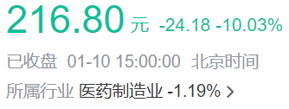
Football Chart Analysis
Evaluation Methods
Stock Price Range (RMB)
Key Assumptions
WACC：5.0%-6.0%
Perpetual Growth：1.5%
Absolute Valuation
DCF
PE multiple：14.15x-83.54x
Net profit attributable to owners: Use 2023’s forecast, 206.21 million.
174
287
EV
EV/EBITDA
EV/EBITDA multiple：10.84x-55.02x
EBITDA：Use 2023’s forecast, 281.79 million. Adjusting net liabilities and minority equity.
45
228
Relative Valuation
MV
P/E
Predicted stock price：174-228
43
253

Slide 27
4
Risk Analysis

Slide 28
4.1 Illegal Operation of Downstream Enterprise
Enquiry Letter Focus: Recombinant Humanised Collagen Products
It is currently the only Class III medical device product: recombinant type III humanised collagen
The relevant products are mainly used for facial injections (medical aesthetics), the company's product sales accounted for a year-on-year increase, mainly sold to medical beauty institutions
The key to the risk lies in the illegal operation and unauthorised sale of Class III medical devices by downstream retailers
Measures for the Supervision and Management of Medical Device Business (2022): Class III medical devices can only be sold to units qualified to operate Class III medical devices and to qualified medical institutions.
Online e-commerce channels are not authorised to sell
Legal Consequence
Unlicensed sales on e-commerce platforms
Measures for the Supervision and Administration of Online Sales of Medical Devices (2018)
Article 44 Where one of the following circumstances exists, the local food and drug supervision and management department at or above the county level shall order correction and impose a fine of 10,000 yuan or more than 30,000 yuan:
(a) The enterprise engaged in the online sale of medical devices sells beyond the scope of business;
(B) the medical device wholesale enterprises to sell to non-qualified business enterprises, the use of units.
There are instances of recombinant Type III humanised collagen being illegally marketed
"As of 31 December 2022, the Issuer had supervised over 40 illegal live broadcasts, issued over 30 warning letters to microbloggers, and reported 8 microbloggers to the Market Supervision Administration; it had identified and taken down over 300 illegal links"
Summary：
Jinbo Bio is the only medical device wholesaler with the ability to sell recombinant Type III humanised collagen, which should be traceable as a Class III medical device. As a result, downstream e-commerce companies are at high risk of being traced and subject to administrative penalties in the event of non-compliance in the sale of this product.
Measures for the Supervision and Administration of Medical Device Operation (2022): Medical device users should properly preserve the original information on the purchase of Class III medical devices and ensure that the information is traceable.

Slide 29
4.2 Institutional regulatory policies tightened
Enquiry Letter Focus: Recombinant Humanised Collagen Products
It is currently the only Class III medical device product: recombinant type III humanised collagen
The relevant products are mainly used for facial injections (medical aesthetics), the company's product sales accounted for a year-on-year increase, mainly sold to medical beauty institutions
The key to the risk lies in Tightening of regulatory measures, unlicensed operation of downstream medical aesthetic organisations
New Law in 2023
主要经销商的下游客户/终端客户情况
Date | File Name | Description
2023年2月 | 《医疗美容消费服务合同（示范文本）》 国家市场监督管理总局 | 医疗美容服务属于医疗活动，未依法取得卫生健康行政部门发放的《医疗机构执业许可证》或者“诊所备案凭证”，不得开展医疗美容服务
2023年5月 | 《关于进一步加强医疗美容行业监管工作的指导意见》 国家市场监督管理总局 | 甲方（消费者）有权要求乙方（美容医疗机构）出示《医疗机构执业许可证》、医师执业资格证书
Unlicensed medical and aesthetic institutions
Name | Description | Main Products
杭州美伊典医疗美容诊所有限公司 | 成立时间：2018 年 注册资本：100 万元 注册地址：杭州市 | 医用无菌Ⅲ型胶原蛋白液、医用重组人源胶原蛋白功能敷料（凝胶型）（无菌型）、重组Ⅲ型人源化胶原蛋白冻干纤维
江苏施尔美整形美容医院有限公司 | 成立时间： 2001 年 注册资本： 600 万元 注册地址： 南京市 | 医用无菌Ⅲ型胶原蛋白液、 重组Ⅲ型人源化胶原蛋白冻干纤维
华韩医疗科学技术股份有限公司 | 成立时间： 2010 年 注册资本： 8,360万元 注册地址： 南京市 | 医用无菌Ⅲ型胶原蛋白液、 重组Ⅲ型人源化胶原蛋白冻干纤维
北京梅颜医疗美容诊所有限公司 | 成立时间： 2018 年 注册资本： 500 万元 注册地址： 北京市 | 医用无菌Ⅲ型胶原蛋白液、 重组Ⅲ型人源化胶原蛋白冻干纤维
北京伍珅医疗美容诊所有限公司 | 成立时间： 2016 年 注册资本： 500 万元 注册地址： 北京市 | 医用无菌Ⅲ型胶原蛋白液、 重组Ⅲ型人源化胶原蛋白冻干纤维
Measures for the Supervision and Management of Medical Device Operation (2022): Class III medical devices can only be sold to units qualified to operate Class III medical devices and qualified medical institutions.
Only in the first round of questioning did Jinbo Bio add the verification of visits to a number of downstream medical aesthetic institutions using the product

Slide 30
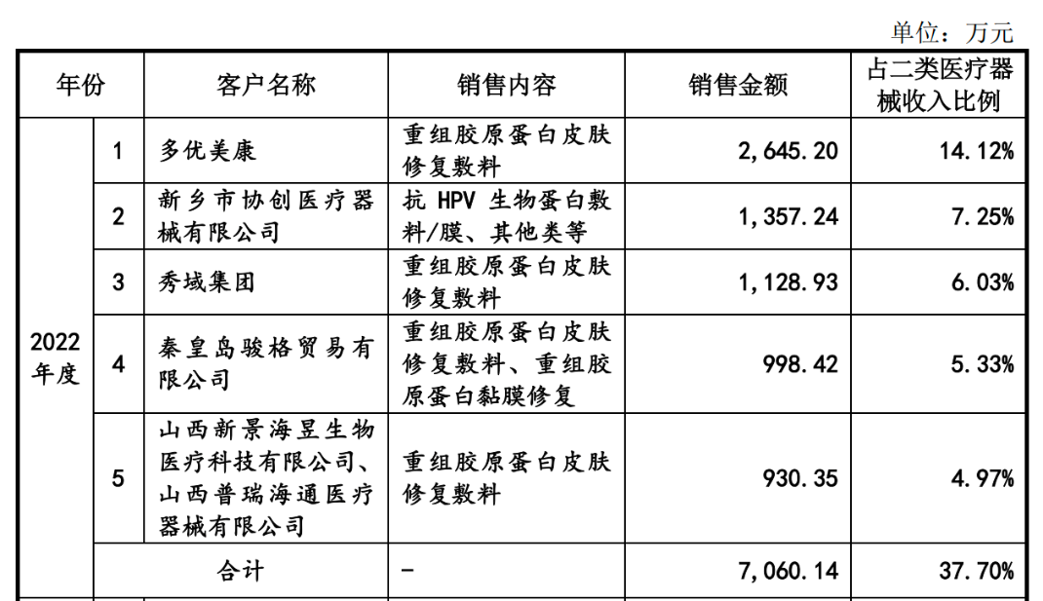
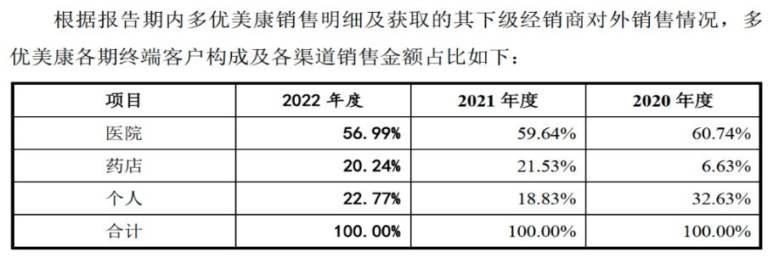
4.3 Unclear disclosure of terminal sales model
Enquiry Letter focused on: sales to individual customers (including legal representatives of the customer's company)
Possibility of extra-circularity of funds
Circumstances exist where individual customers do not want invoices in exchange for discounts
Kibo Bio licensed DuoYouMeKang to permanently sell recombinant collagen medical devices and exclusively sell 4 types of dressings.
DuoYouMeKang is the largest customer of Jamboree Bio's Class II medical devices.
Problems for Duo Umicom
Reasonableness of sales by Doylecom and its sales department to individual customers
"There are cases in which some non-primary customers purchased products from the sales department of DuoYuMeiKang for their own use, gifts, market development and other purposes, and there are also cases in which the legal representatives or salesmen of some of the customers' companies purchased products from the sales department of DuoYuMeiKang."
Doyumecon is highly dependent on the personal customer sales channel and has not answered the invoice question
资料来源：锦波生物第一轮问询回复，锦波生物第二轮问询回复，锦波生物关于落实上市委员会审议会议意见的函的回复

Slide 31
5
Analysis from the founders’ perspective

Slide 32
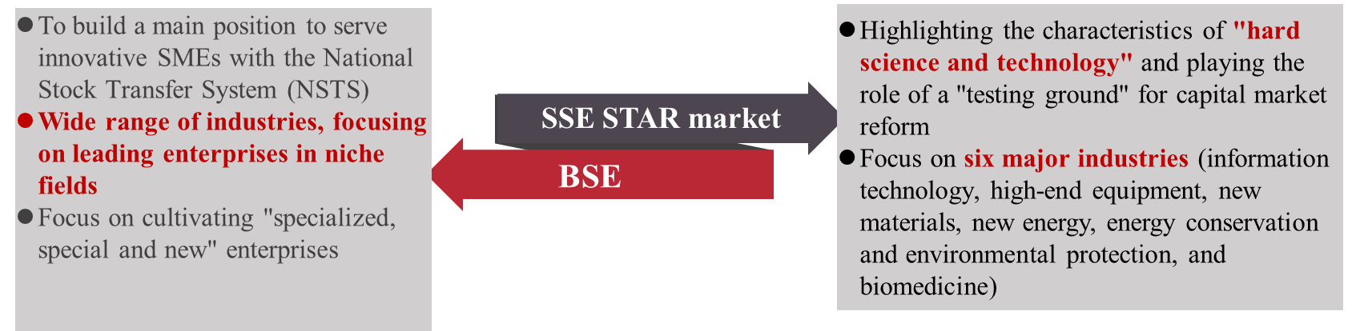
Analysis from the founders’ perspective
Development of the Company —— Necessity
Main Purpose of the Fund-raising
Project Name | Total Investment | Amount of Fund-raising Investment
Recombinant Humanized Collagen New Material and Injectable Product R&D Project | 23,200 | 20,000
Brand building and marketing project | 15,000 | 15,000
Supplementary working capital | 12,000 | 12,000
合计 | 50,200 | 47,000
External Market Environment —— Feasibility
Recombinant collagen industry's policy, regulation and competition situation
Choice of listing segment and reasons

Slide 33
Analysis from the founders’ perspective
Development of the Company —— Necessity
Recombinant Collagen R&D Project
The company's significant growth in revenue in the last three years came from the growth of recombinant collagen products.
The application rate of recombinant collagen in skin care products is gradually increasing, and the industry has a bright future.
The Company will focus on the R&D and application of recombinant collagen in the future to expand its market share in the medical aesthetic industry.
Company's Revenue and Growth Rate, 2020-2022

Slide 34
Analysis from the founders’ perspective
Development of the Company —— Necessity
Recombinant Collagen R&D Project
The company‘s R&D expenses will be RMB 23,769,900, RMB 29,069,300 and RMB 45,412,500 in
2020, 2021 and 2022 respectively.
The project is expected to raise $200,000,000, which is expected to cover the R&D expenses for 3-5 years.
The company's recombinant collagen project is expected to focus on the registration and filing period in 2025 and 2026.
Project Name | Project Progress | Basic Research | Dosage form Study and Effective Date Observation | Animal Research | Clinical Research | Registration
Recombinant Humanized Collagen 001 | Basic Research | Completed | 2023.12 | Completed | 2023.07 | 2025.03
002 | Basic Research | Completed | 2025.12 | 2024.06 | 2025.06 | 2026.06
003 | Basic Research | 2023.06 | 2025.08 | 2024.03 | 2025.04 | 2026.04
004 | Basic Research | 2023.06 | 2025.12 | 2024.06 | 2025.06 | 2026.06
005 | Basic Research | 2023.12 | 2025.09 | 2024.06 | 2025.06 | 2026.12
006 | Basic Research | 2023.12 | 2025.07 | Completed | 2024.07 | 2025.07
Project Name | Project Progress | Basic Research | Dosage form Study and Effective Date Observation | Animal Research | Clinical Research | Registration

Slide 35
Analysis from the founders’ perspective
Development of the Company —— Necessity
Brand Building and Marketing Program
Brand promotion is mainly for various types of academic conferences and exhibitions, as well as strengthening brand influence through online platforms and advertising.
The Company's selling expenses in 2020, 2021 and 2022 will be RMB37,535,100,000, RMB55,967,100 and RMB104,951,700,000 respectively, accounting for 23.27%, 23.98% and 26.90% of the operating revenue respectively. It mainly includes sales staff remuneration and publicity and promotion expenses.
The project is expected to raise RMB 150,000,000, which is expected to cover the sales expenses for 1-2 years.
Supplementary Working Capital
Jinbo Bio's previous sources of funding were mainly self-accumulation, bank loans and commercial credit loans.
The financial expenses in 2020, 2021 and 2022 will be RMB1,750,600,000, RMB1,802,700,000 and RMB8,063,000 respectively.
The financial expense increases significantly in 2022 and is already too high, so it is financially necessary for Jinbo Bio to utilize equity financing.
Recombinant collagen products

Slide 36
Analysis from the founders’ perspective
External Market Environment —— Feasibility
Reorganization of Collagen Industry
Along with the release of favorable policies, the industry is expected to continue positive growth in the future.
The policy and regulatory requirements for stick-on dressings have been gradually strengthened, raising the barriers to entry into the industry.
China's overall collagen products market size continues to grow, and is expected to grow to 173.8 billion yuan by 2027.
Some companies in the industry R & D expenses and accounted for far less than the marketing expenses, the follow-up competition is weak.
Release Date | Relevant Policies | Core Content
2021.03.15 | Guidelines for Naming Recombinant Collagen Biomaterials | Guidance on the naming of recombinant collagen biomaterials in the field of medical devices(excluding collagen biomaterials extracted from animal tissues)
2021.04.15 | Principles for Defining the Classification of Recombinant Collagen-based Medical Products | Regulating the Management Attributes and Judgment of Management Categories of Recombinant Collagen-based Medical Products
2022.03.24 | Adjustment of some contents of Classification Catalog of Medical Devices | Since April 1, 2022, cold paste and cold gel products shall not be continued to be manufactured and imported as Class I medical devices

Slide 37
Analysis from the founders’ perspective
External Market Environment —— Feasibility
Listed on the Beihai Stock Exchange
The Bejing Stock Exchange mainly serves leading companies in niche fields, and compared with the SSE Star market, Jinbo Bio is more in line with the positioning of the Bejing Stock Exchange.
The listing standard of the SSE Star market is more stringent, with higher requirements on operating revenue and net profit.
The company‘s recombinant collagen products are still in the research and development stage, coupled with the recombinant collagen industry is still in the concept of popularization stage, the company’s performance is not as expected。

Slide 38
Thank You

